Slide 1

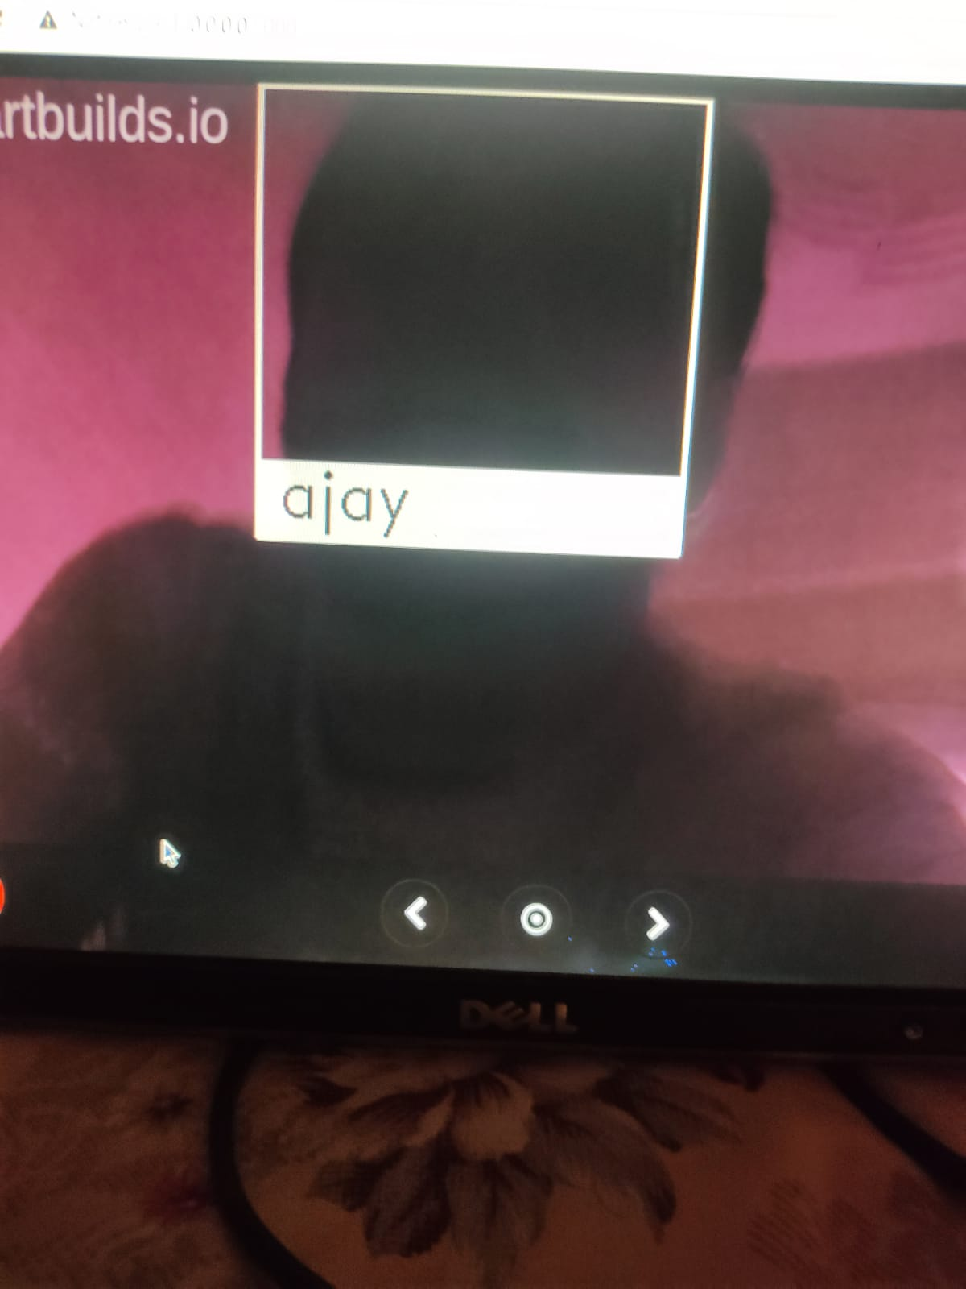
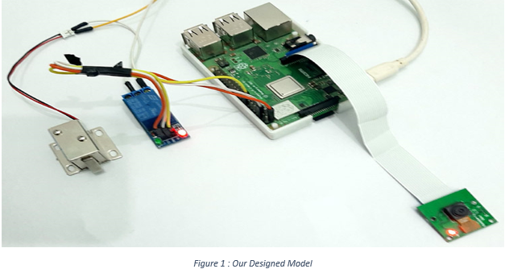
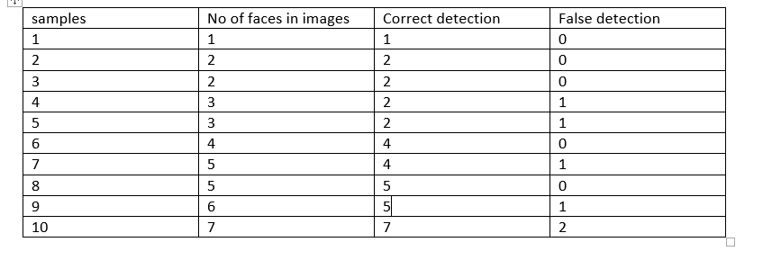
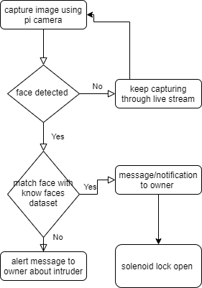
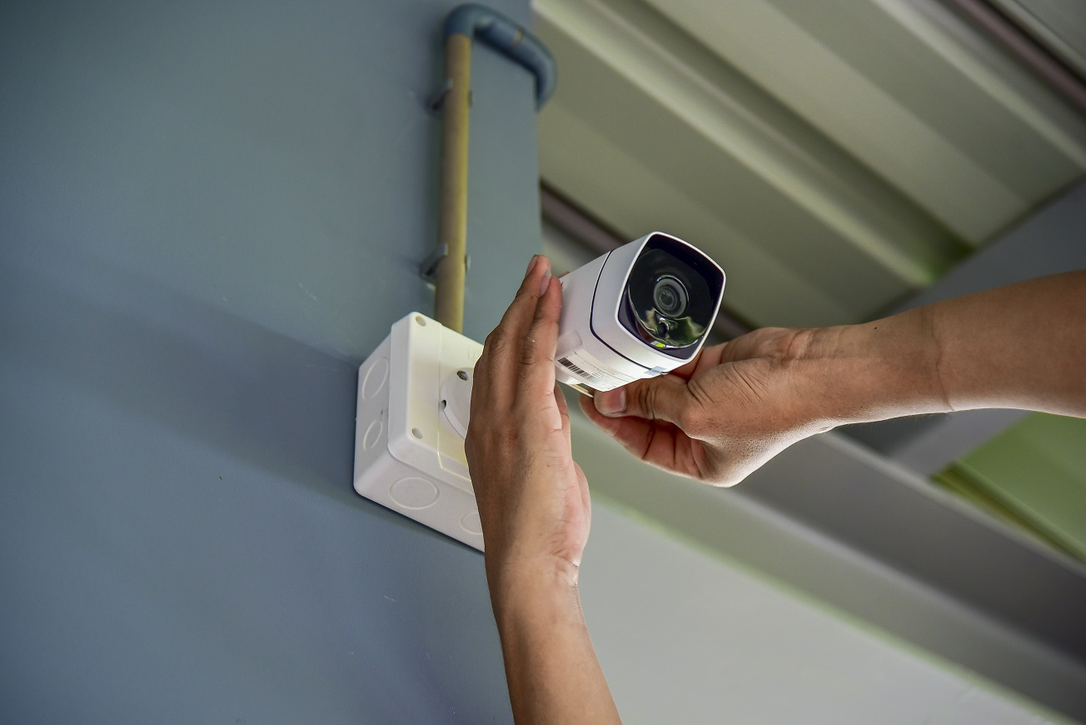
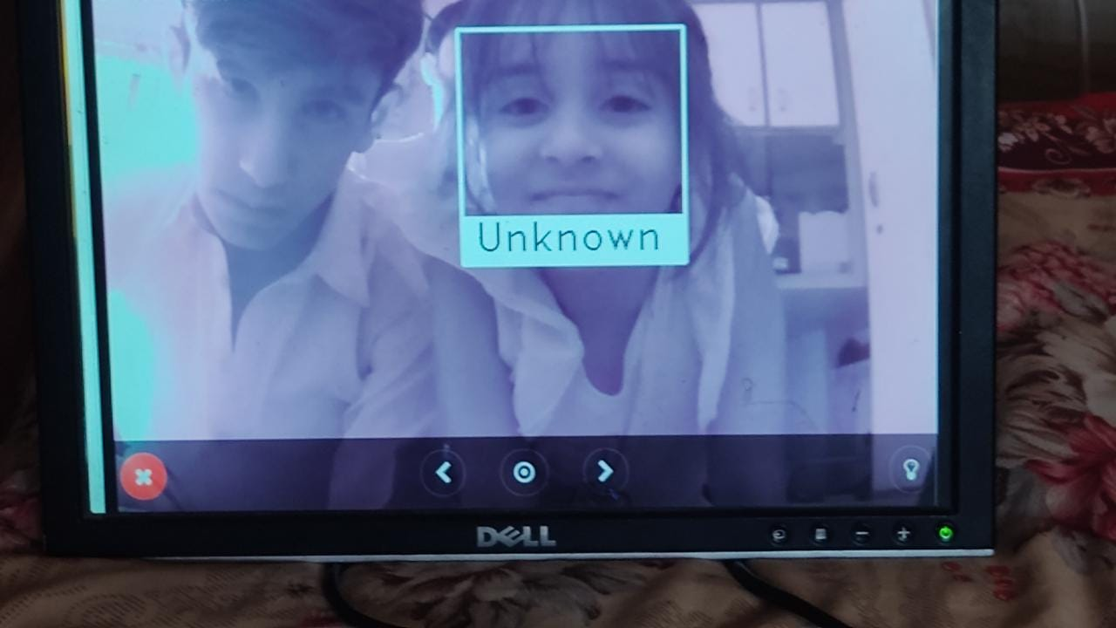
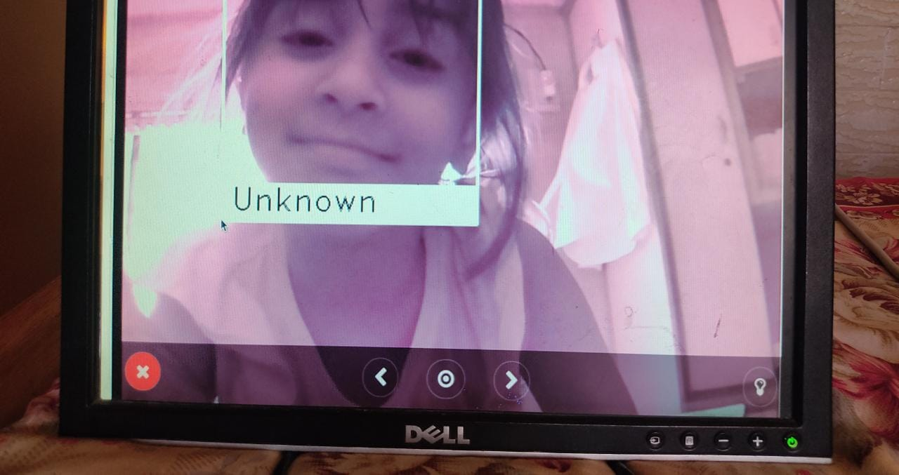
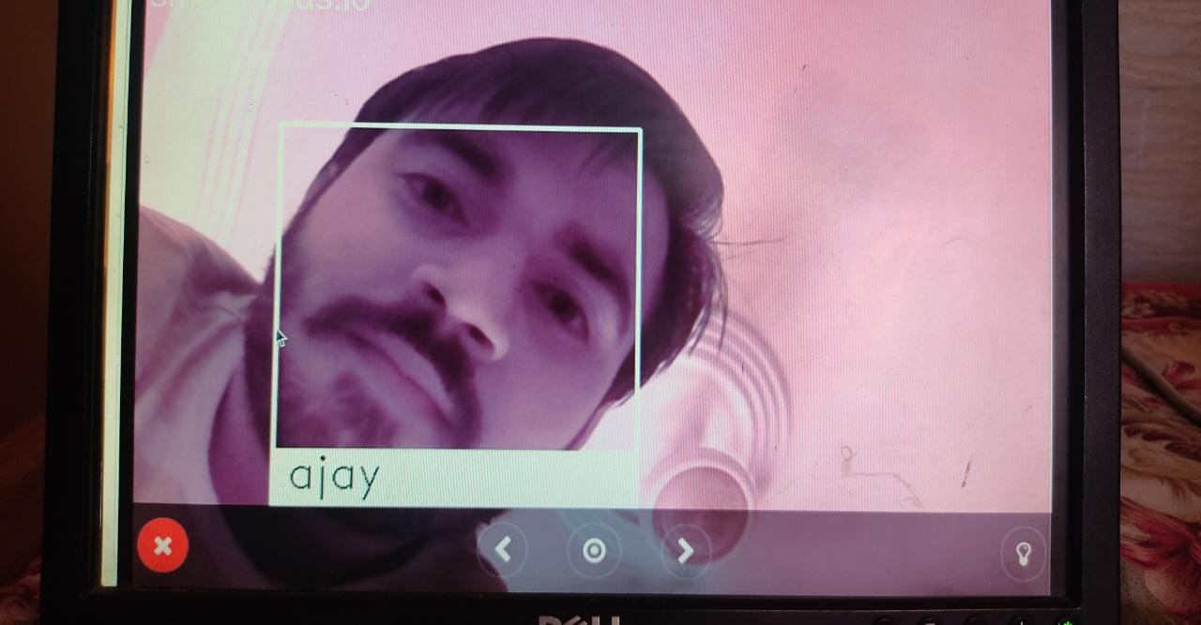
Smart Surveillance System
Mehran University of Engineering and Technology
Department of Computer System Engineering
ABSTRACT and BACKGROUND
METHODOLOGY
Along with face detection and recognition in day light , it also detect faces in night/dark time. This built in surveillance raspberry pi camera has also night vision facility , which helps the detection in dark.
This table contains total number of samples , the number of faces which will appearing while face detecting by camera ,along with it shows the correct detection and false detection of each samples. It helps to identify the differences.
Abstract
Human face detection in any criminal activity has been a challenging issue in the areas of image processing & recognition. But Security and Authentication is an imperative part of any industry. Hence, this paper pro-posed a surveillance camera by employing Raspberry Pi and IoT. So The CCTV is used for surveillance and security purpose. In Real time, Human face recognition can be performed in two stages such as, Face detection and Face recognition. This paper implements “Haar-Cascade algorithm” to identify human faces from provided Data-Base, which is organized in Open CV by Python language. Haar feature-based cascade classifier system utilizes only 200 features out of 6000 features to yield a recognition rate of 85-90%.So This system will monitor via Twilio app when motion detected and checks for the faces in the image captured and with the help of face recognition alerts message if the face detected is not stored in the database.If not, soo , then the Solenoid lock which is connected with Raspberry-Pi camera will be unlocked. With the help of Open-CV, test results on images of people under different occlusions and illuminations and some degree of orientations and rotations, in both training set and test set show that the proposed algorithm is effective and achieves state-of-the-art performance. Furthermore, it is efficient because of its easiness and simplicity of implementation. Moreover, IOT based app can be used remotely to view the activity and get notifications when Intruder is detect in owner absence.
Keyword: Python3, Open-Cv, Haar-Cascade Algorithm,Twillio, Solenoid Lock ,Raspberry PI and Raspberry-Pi camera
Background
Security and Authentication is an imperative part everywhere to protect your personal assets.
Surveillance is one of the important aspects in various fields such as banking sectors, military areas, or personal security.
Due to exponential rise in burglary and theft activities, surveillance systems are proving to be a great source of security.
Our proposed solution composed for hardware and software integration .we have use Haar-Cascade algorithm with its frontal face model which is fully trained model .
Using raspberry pi and its camera we are capturing live stream ,if any face is detected in front of the camera ,the encoding of the face are passed to the model which will match the face features with the datasets of known person faces already stored
Figure 1: Working model of the smart surveillance system composed of raspberry pi ,camera ,relay and solenoid lock.
if the face gets recognized the raspberry pi will send signal to solenoid lock to unlock which is integrated with pi through GPIO pins.
As soon the face is detected an alert message will also be generated through an Twilio app and will sent to owner mobile number so that owner get updated upon each activity at his house.
Our camera is also connected with an remote application through which owner can watch livestream of his house .
Flowchart shows how our proposed system works
So this flow chart basically start procedure from detecting the face , and our built-in system will match all the faces with stored database . IF the intruder face match then the lock will be unlocked if not then alert message will be generate . That’s all the flow of our designed system
CONCLUSIONS
It’s a new smart surveillance system which is detecting faces with 86% accuracy and in different condition whether in daylight on in night.
The system is integrated with alert notification so no chance for intruder infiltration .
We have developed a smart surveillance camera which is capable of providing both face detection and face recognition.
Our module is very compact in size and shape and it its cost efficient with low maintenance.
Our remote based app provide live stream is something new which is very beneficial for owners to watch their home from any side of the world .
Provides best security in the absence of Owner in the home.
Convenient to maintain door lock system.
REFRENCES
[1] Dhanshri Mali, Ramesh RTP, Nagaraj Dharwadkar, Chaitanya R. Devale, and Om-prakash Tembhurne. Real-time smart surveillance system using raspberry pi. (March21, 2019).
[2] Akash hinmaya Kaundanya, Omkar Pathak and Sanket Parode Nalawade. Smartsurveillance system using raspberry pi and face recognition. 6, 2017/4.
[3] Kanaga Suba Subramanian. 22 face recognition using haar - cascade classifier forcriminal identification. 11 2020.
[4] G.V.Vijay N.Sugumaran and E.Annadevi. Smart surveillance monitoring system usingraspberry pi and pir sensor. April 2017.
[5] Bandi Narasimha Rao and Reddy Sudheer. Surveillance camera using iot and rasp-berry pi. pages 1172–1176, 2020.
Objectives
Aims and Objective
To identify the individuals, trying to get into the house whether they belong from the house or not.
Auto door, will unlock so that person with successful recognition can get into the house without disturbing any other person.
Alert notification on each face detection whether its known or unknown so that owner remotely gets updated about all activities .
Live streaming of Home camera will also be monitored by owner remotely .
RESULTS
We tested our system on various sample and in different conditions like in daylight and in night to check our classifier accuracy .in each sample we checked for detection of multiple no of faces and counted correct detection.
Figure 2: It shows single face sample and multiple face sample Detection
GROUPS MEMBERS
Group 01
Supervisor : Dr Moazzam Jawaid
Members are:
Khalilullah Nohri G.L (17CS59)
Ajay Kumar (17CS77)
Hamza Nadeem (17CS103)
Department of Computer Systems Engineering Mehran University of Engineering and Technology, Jamshoro

